Slide 1
Unpaired Image-to-Image Translation using Cycle-Consistent Adversarial Networks
- Jun-Yan Zhu, Taesung Park, Phillip Isola, Alexei A. Efros

Slide 2
CycleGAN Introduction
CycleGAN is a type of Generative Adversarial Network (GAN) designed to perform image-to-image translation tasks without requiring paired training data.
Its applications are convert a photograph into the style of a famous painting, can transform images taken in one season to appear as if they were taken in another season, facial attribute manipulation, such as changing the age, gender, or expression of faces in images etc.
Unlike models relying on explicit likelihood estimation, GANs capture complex data distributions without computing likelihood.

Slide 3
Cycle GAN Architecture
CycleGAN uses two sets of Generators and Discriminators one for each image domain. The components of the architecture are as follows.
Two Generators (G and F):
G: Translates images from domain X to domain Y.
F: Translates images from domain Y to domain X.
Two Discriminators (D_X and D_Y):
D_{X}: Discriminates between real images from domain X and fake images generated by F.
D_{Y}: Discriminates between real images from domain Y and fake images generated by G.

Slide 4
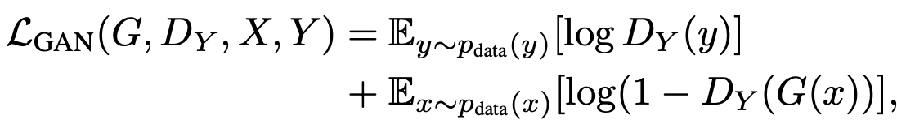
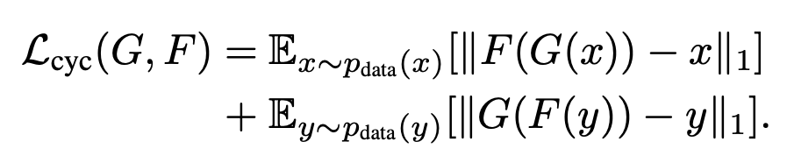
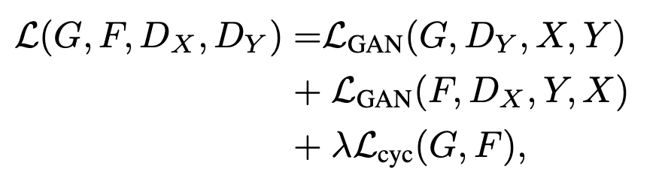
Cycle GAN Loss Functions
Adversarial Loss:
The adversarial loss is fundamental to the GAN framework, helping each generator to produce images that look as real as possible so that the corresponding discriminator cannot easily distinguish them from true images of the target domain.
Cycle Consistency Loss
The cycle consistency loss is crucial in CycleGAN to ensure that each image can be translated to the other domain and back again without losing its original content. This loss helps to mitigate the issue of mode collapse commonly observed in GANs.
Total Loss function

Slide 5
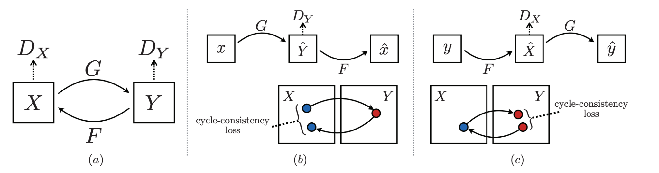
Cycle GAN Architecture and Loss
Fig (a) shows the two mapping functions G : X → Y and F : Y → X, and associated adversarial discriminators D_{Y} and D_{X}
Fig (b) shows forward cycle-consistency loss: x → G(x) → F (G(x)) ≈ x
Fig (c) shows backward cycle-consistency loss: y → F (y) → G(F (y)) ≈ y

Slide 6
Cycle Gan Implementation
Generator network architecture is adopted from Johnson et al., known for effective neural style transfer and super-resolution applications.
The network comprises:
Three initial convolutional layers for preliminary image processing.
Several residual blocks to aid complex feature learning:
Six blocks for images of 128x128 pixel resolution.
Nine blocks for images of 256x256 pixel resolution or larger.
Two fractionally-strided convolutions with a stride of 1/2, used for upsampling.
A final convolutional layer that maps features to the RGB color space.
Instance normalization is applied throughout the generator network, enhancing performance in style transfer tasks as indicated by Johnson et al.
The discriminator network utilizes 70x70 PatchGANs, which assess whether 70x70 overlapping image patches are real or fake.

Slide 7
Training Process
Two techniques from recent works are applied to stabilize the model training procedure. The first technique involves modifying the LGAN by replacing the negative log-likelihood objective with a least-squares loss. This change is more stable during training and produces higher quality results.
The Generator and Discriminator are trained to minimize the Adversarial Loss.
For all experiments, the lambda (λ) value is set at 10.
The Adam solver is used with a batch size of 1.
All networks are trained from scratch with an initial learning rate of 0.0002, which is maintained for the first 100 epochs and then linearly decayed to zero over the subsequent 100 epochs.

Slide 8
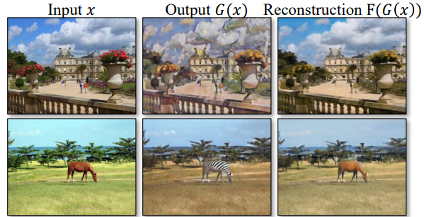
Cycle GAN Images

Slide 9
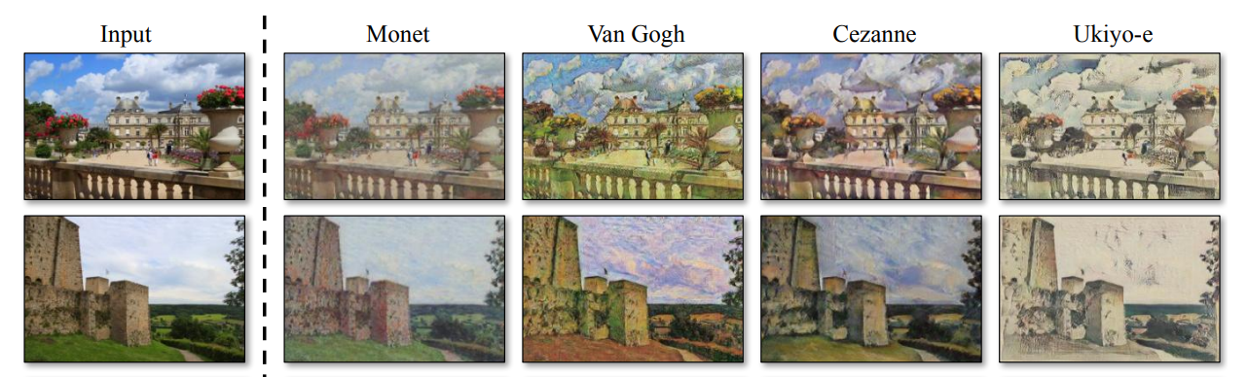
i

Slide 10
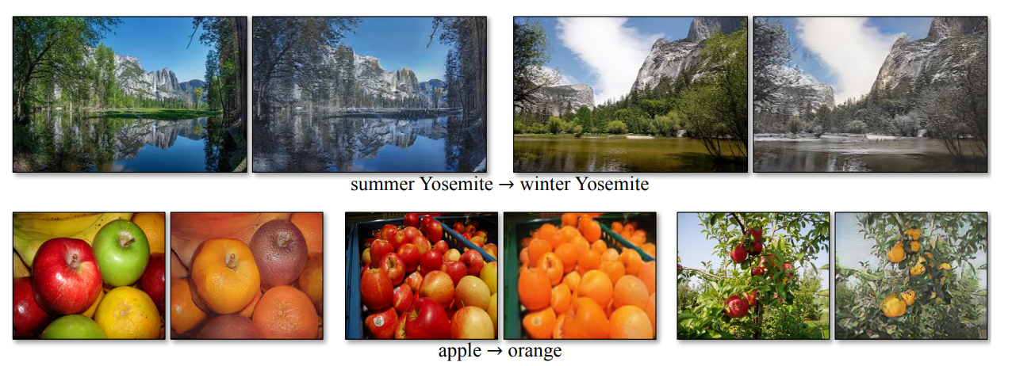
i

Slide 11
Result Analysis
PROS:
High Perceptual Realism: The method achieves perceptual realism comparable to fully supervised approaches like pix2pix, as demonstrated by the AMT perceptual studies.
Quantitative Evaluation: By employing FCN scores and semantic segmentation metrics, the study provides quantitative assessments of the generated outputs, enhancing the credibility of the results.
Superior Performance: CycleGAN consistently outperforms baseline methods across various evaluation metrics, indicating its effectiveness in tasks such as semantic labels→photo translation and map↔aerial photo translation.
Comprehensive Analysis: The study conducts ablation studies to analyze the impact of different components of the loss function, providing insights into the mechanisms driving the model's performance.

Slide 12
i
CONS
Training Instability: Variations in loss direction, such as GAN + forward or backward cycle loss, are reported to cause training instability and mode collapse, which can hinder the convergence and quality of generated outputs.
Limited Generalization: Although CycleGAN achieves impressive results in certain tasks, it may struggle with more complex transformations, particularly those requiring significant geometric changes. This limitation suggests potential challenges in handling diverse and extreme transformations.
Scalability: The study trains models on 256 × 256 images instead of higher resolutions used in some baselines like pix2pix. While this choice may improve scalability, it could also limit the model's ability to capture fine details in high-resolution images.
Human Bias in Perceptual Studies: Perceptual studies conducted on AMT rely on human judgments, which may introduce bias or variability based on individual perceptions. This subjectivity could affect the reliability of the reported perceptual realism scores.

Slide 13
Cycle GAN Limitation
While our method often succeeds in tasks involving color and texture changes, it struggles with geometric transformations, such as dog to cat transfiguration, where it makes minimal alterations.
Generator architectures tailored for appearance changes may hinder performance on tasks requiring more varied and extreme transformations, highlighting the need for improved handling of geometric changes.
Failures are sometimes attributed to dataset distribution characteristics; for instance, confusion in the horse to zebra example due to training on synsets lacking certain real-world scenarios.
Despite advancements, a gap remains between results from paired training data and our unpaired method, indicating the potential need for weak semantic supervision to address ambiguities and integrate semi-supervised data for more robust translators.

